Slide 1
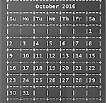
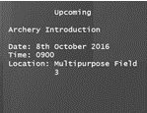
SmartyDo
New task added: Archery
>> Add /d Archery Introduction /st 0900 /loc Multipurpose Field 3

